Slide 1







MGMT 6058 Module 10
Exercises
Do the exercise prior to next slide
Videos
Solution Slide
PPT Animations
Project Evaluation
and Control: Monitoring Project Performance
Exercise Simulation
See text in “slide note” for more details
M10 6058 Tom Jeff Sue Carol 12.1 w Labour & Mat Cost.mpp
M10 HANDOUT Tracking Gantt w question blanks.docx
Printout
Use Word

Slide 2
Module 10 Learning Objectives
Understand the nature of the control cycle and four key steps in a general project control model.
Understand the use of milestones including variations in MS Project
Understand the use of a Tracking Gantt Chart in MS Project.
Recognize the strengths and weaknesses of common project evaluation and control methods.

Slide 3
We have now planned our project, now it is time to monitor and control it during execution.
Are we on schedule and on budget?
We want to stay on top of this as project moves through its control cycle.
Do not adopt the “no news is good news” approach as there will be too many surprises too late to do anything.
What should be measured and when?

Slide 4
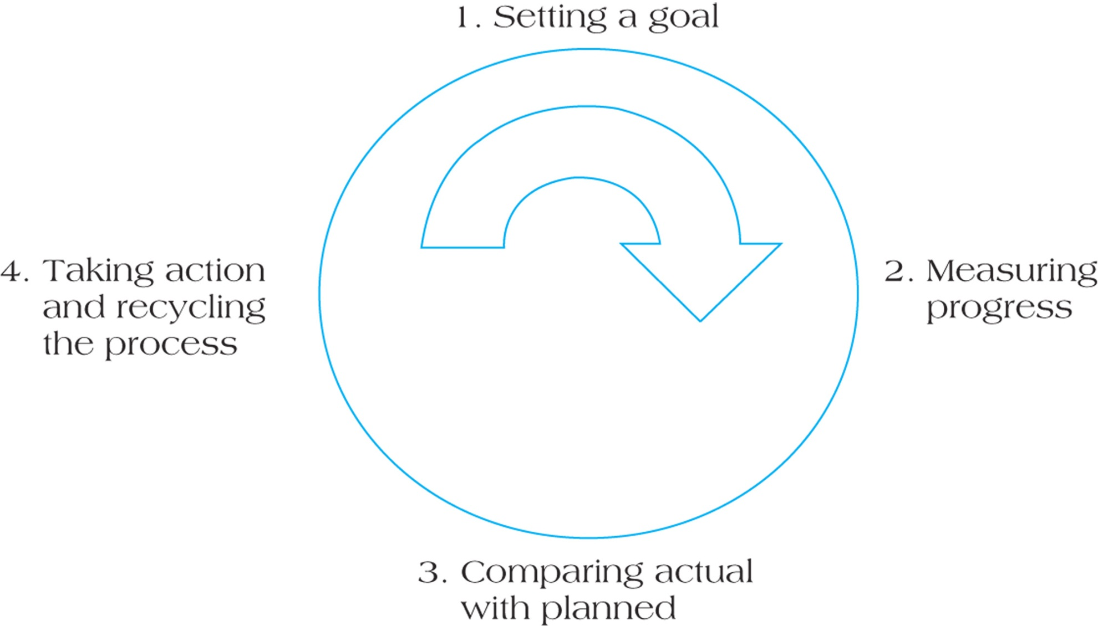
The Project Control Cycle
Involves the project baseline plan, the WBS that contains all deliverables and work packages and who is responsible.
If gap is significant corrective action must take place. After corrective action takes place the monitoring and control cycle begins again.
Need a system that allows one to measure ongoing status of various projects in real time. What and when to measure needs to be decided.
What is the difference between what was planned and what has actually occurred – if gap is significant it is a warning sign that something must be done.
Figure 13.2

Slide 5
Milestone Analysis
Milestones are events or stages of the project that represent a significant accomplishment.
Milestones
show completion of important steps
signal the team and suppliers
can motivate the team
offer reevaluation points
help coordinate schedules
identify key review gates
delineate work packages
Real Life Examples?

Slide 6
Milestone Chart Example
Status Date
MS1
MS2
MS3
MS4
MS5
MS6
MS7
Time
Scheduled
Complete
Late (not finished)
We would want to know why MS4 is complete but not MS3.

Slide 7
Problems with Milestones
They are a reactive control system!
Sometimes we need progress reports before the milestone so that problems are not compounded and beyond the point of no return.
If there are 9 sequential actives prior to a milestone, we’d like to know things are not going well after the 2nd or 3rd, rather than finding out after the 9th.
Usually milestones are only on the critical path, but what happens if the critical path changes?
How would we know what's happening on the non-critical paths?
Notes:
Milestones are probably the simplest and most widely used of all project control devices because they are so clear.

Slide 8
Monitoring Project Performance
We are establishing a project baseline for a simple project by creating our project schedule and budget.
Retrieve the file below from this Module (on FOL under Module 10).
M10 6058 Tom Jeff Sue Carol 12.1 w Labour & Mat Cost.mpp
Notes:
Project 12.1 is the selection of the winning bid among various entries. We need to baseline the mpp first so we can use Tracking Gantt later on, but for now we just use a Gantt

Slide 9
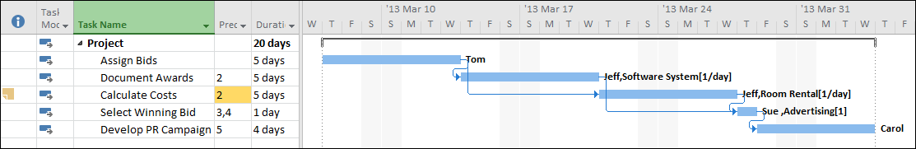
Our Project - Tom Jeff Sue Carol 12.1
We have 3 green FS relations circled, but the red circle is NOT an FS relationship between the 2nd and 3rd tasks.
The 3rd task, "Calculate Costs" along with the other tasks is auto scheduled, and it could have started right after the 2nd task, but there is NOT an FS relationship arrow between the 2nd task and the 3rd task as there is between the other tasks.
This is because Jeff is working on both “Document Awards” and “Calculate Costs” and was overallocated, so we used the Leveling Gantt Chart and added a leveling delay to “Calculate Costs” so Jeff would not be overallocated. Note how easy it is to “assume” the 3rd task is dependent on the 2nd task.

Slide 10
Add the following Milestones to Example 12.1
Milestone | Predecessor
Bid Review | C. Document Award
Bid Award | D. Select Winning Bid
On the Task Tab in the Gantt chart view, click on the task that will be after the milestone, then click on the Task tab and then milestone. Note, we could also just enter a new task and make the duration zero.
Enter Milestone Name and predecessor.
For the 1st milestone, create it with just a predecessor “Document Award”. For the 2nd milestone create it with both a predecessor and a successor, and remove the existing FS relationship.
Keep this file open for later use.

Slide 11
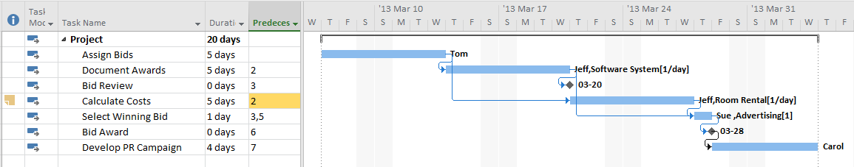
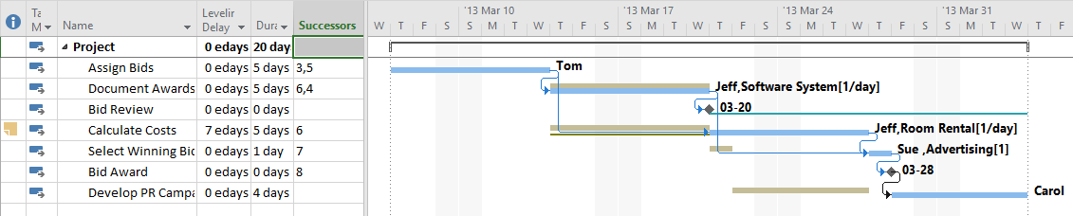
Example 12.1 with Milestones Added
Gantt View
We can now see the 2 milestones we added in both views, and we can see why “Calculate Costs” doesn’t start after “Assign Bids” -- if you look very closely, you can see there is not an arrow between the 2 activities. And you can see from the Gantt Chart and Predecessors column that Calculate Costs is not dependent upon Bid Review, and you can see the same in the Leveling Gantt View but via the Successors column.
Leveling Gantt View

Slide 12
Monitoring Project Performance
Now that we have added milestones to our project plan, we’re ready to baseline the project in MS Project, which will create a schedule baseline and a cost baseline.
On the Project Tab select “Set Baseline”, click on “Set Baseline” again, and click “Okay”. Now we can monitor and control this project by comparing Activity actuals or changes to our plan, with the original baseline schedule.
We are baselining our 12.1 Project
M10 6058 Tom Jeff Sue Carol 12.1 w Labour & Mat Cost.mpp
Notes:
Project 12.1 is the selection of the winning bid among various entries. We need to baseline the mpp first so we can use Tracking Gantt later on, but for now we just use a Gantt.

Slide 13
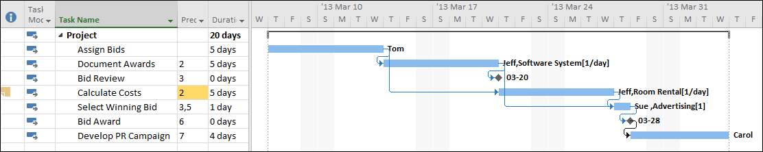
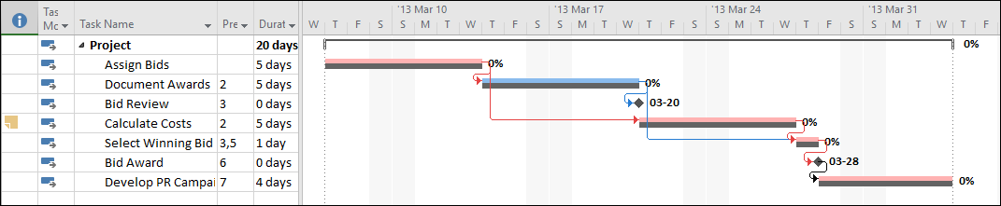
Example 12.1 with milestones after baselining
We’re in the Gantt Chart view above, so nothing looks different after baselining. But in the Tracking Gantt below, we can see our Schedule Baseline in dark grey.
Note that our 2nd task is NOT showing as a red Critical Path task. This is because of our manual leveling delay we inserted for the 3rd task. Look a the merge coming into the 4th task.

Slide 14


Example 12.1 with Milestones - Issues
We’re back in the Gantt Chart view, but let’s look at how the 3 approaches are different.
#1
#2
First, note the 4th task (NOT the 3rd) is dependent on the 2nd task but also note, the 4th task is NOT dependent on the milestone being completed prior to starting the 4th task.
Note the 5th task is only dependent on the milestone, so the milestone has to be completed before the 5th task can begin.
#3
We could have also added an FS arrow between the 4th and 5th tasks, but it ends up as the same logic as the 1st milestone
Notes:
You can see that #1 and #3 are the same logically, the successor task is NOT dependent on the milestone, but #3 does graphically look busier than #2 so we might just use #1.
And in #2, the successor IS dependent upon the completion of the milestone. We might use this approach when we really want the milestone success criteria applied to the predecessor task, before we start the successor task. An example might be there are safety checks that have to be performed on a “completed” task (via the milestone), before we believe it’s safe to start any follow-on task.

Slide 15
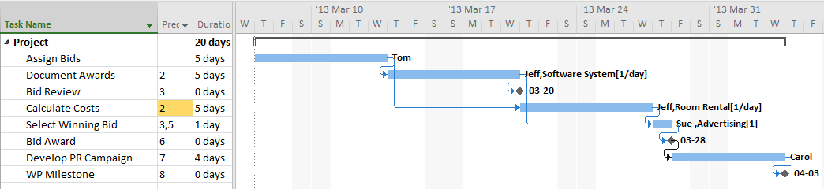
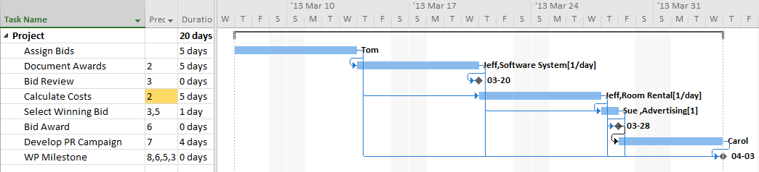
Example 12.1 with Work Package Milestones
Let’s create milestones for our Work Package, we can add a milestone after the last task, “Develop PR Campaign”, this is the most common approach.
Approach A
But what if we wanted to be 100% sure all of the WP tasks were done, not just the last one and most of the others? Could we add multiple arrows?
Approach B
Notes:
We might use Approach B when it’s critical to ensure all of the previous tasks are 100% complete. For example we might have stalled completing the 2nd task, but we managed to complete 90% of it before we stalled, which was enough to continue to 100% complete the 3rd, 4th and 5th tasks. Because our 5th task was complete, it passed the milestone but the 2nd task is still sitting at 90% complete.
An example, we could have a situation where it’s really not safe to say a WP is complete or finished, unless all of the tasks are complete. The 2nd task might have been a high voltage electrical wiring task for the construction of a room where flammable material was going to be stored.

Slide 16
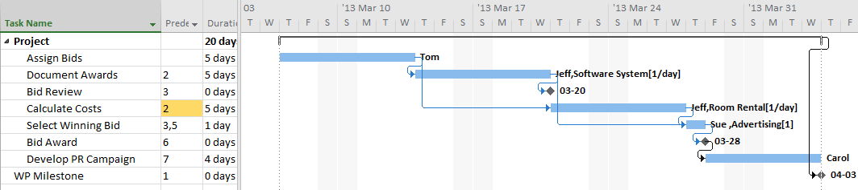
Example 12.1 with Work Package Milestone Issues
The approach where a milestones is added to a Work Package is absolutely NOT Recommended.
Linking a milestone/detailed task to a summary task, is essentially linking an Activity to a Deliverable. They are not the same thing and can trigger false data in MS Project files, as well other logical flow issues in planning. However you may see this used in industry.
Approach A
Approach B
Link the milestone to the last Task
Link the milestone to all the Tasks
A
B
Both Approach A & B are used with the use of B being an unusual exception for special circumstances.

Slide 17
The Tracking Gantt Chart
It is useful for evaluating project performance at specific points in time.
It allows the project team to constantly update the project’s status by linking task completion to the schedule baseline.
Benefit are that they are quite easy to understand and can be quickly updated.
Drawbacks are they do not identify the underlying source of the problems in schedule slippage and they do not allow for future projections.
Should be used with other techniques for offer future projections.

Slide 18
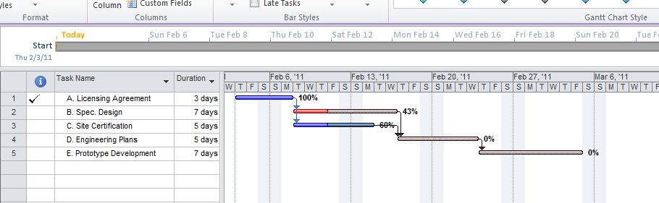
Assessing a Project’s Status Using a Gantt Chart
The Gantt Chart indicates what % of an activity is complete (e.g. Spec Design is 43% complete) and we can also see the graphical progress via the darker red in the bar.
Figure 13.6
But does this schedule represent the original planned schedule (the baseline schedule)? How do we know the original schedule hasn’t been delayed 3 times in this Gantt Chart and we are way behind the original schedule? We need a Tracking Gantt.

Slide 19
Update Tom Jeff Sue Carol 12.1 mpp
Base line the project if not already done
Status the project
In the Tracking Gantt Chart view, click on the Project Tab and the “Update Project” option.
Set the Status Date to Mar 18, 2013.
Update work as complete through to the status date
Select - Set 0%-100% complete
Select - Entire project
You will see that the program assumes all tasks are successfully completed to 13 Mar 18.
A solid bar is drawn through the middle of the activities complete, while a partial bar appears in activities partially complete. A check mark appears for activities completed.
We can also update the project on a task-by-task basis by clicking on the Task tab and then highlighting the tasks in order. We can mark each task as “Mark on Track” or we can manually click the options to the left of the “Mark on Track” and assign project completion rate of 0%, 25%, 50% etc. We can also status the activity by double clicking on the task name and enter the percent complete on the General tab.
Or we can click on the % complete part of the bars by clicking and hovering until we see the % sign and then dragging with the mouse.
We can also put actual start and finish dates, if we use the Tracking Table with the Tracking Gantt View.

Slide 20
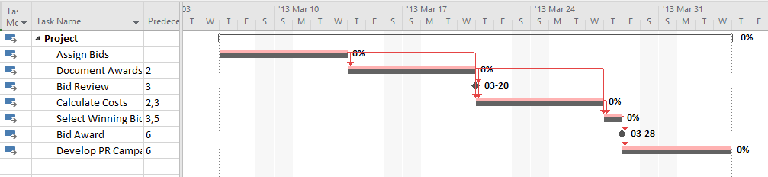
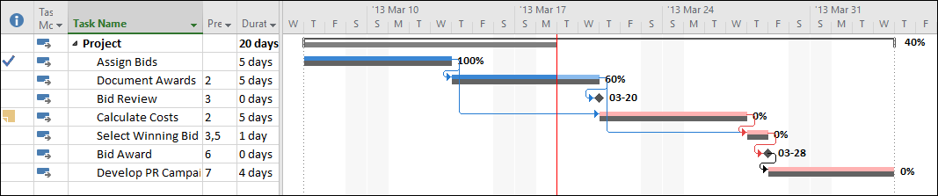
Update Tom Jeff Sue Carol 12.1 mpp
Here is our Tracking Gantt Chart, the project was baselined
Mar 18
Here is our Tracking Gantt Chart after we clicked on “Update Project” based on a Status Date of Mar 18, 2013
Notes:
You will see that the program assumes that all tasks have been successfully complete to March 18, 2013.
A solid bar is drawn through the middle of the activities complete, while a partial bar appears in activities partially complete. A check mark appears for activities completed.
The Status Date can be entered from the Project tab, then going to the Status and clicking on the calendar icon.
The Status Date line is made visible by going to the Format tab, then Gridlines, select Gridlines again, scroll and select Status Date, pick a Type and a Color of line, and then OK.

Slide 21
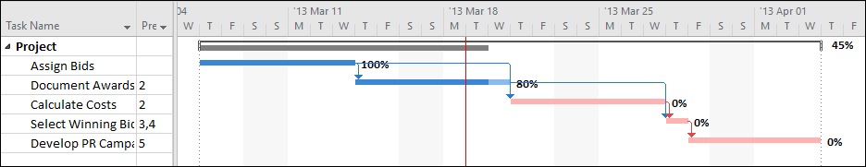
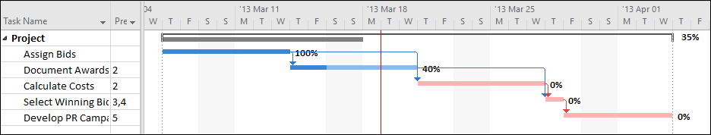
Updating the Project, Tom Jeff Sue Carol Examples of Ahead of Schedule, Behind Schedule
Here the project is running ahead of schedule
And in this example the project is running behind schedule

Slide 22
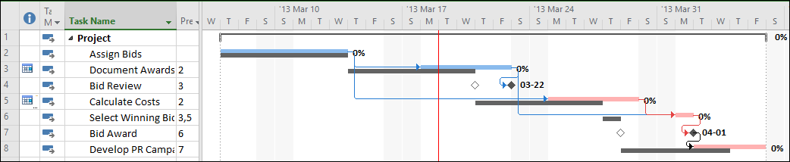
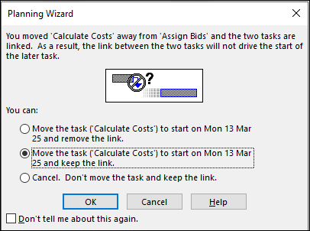
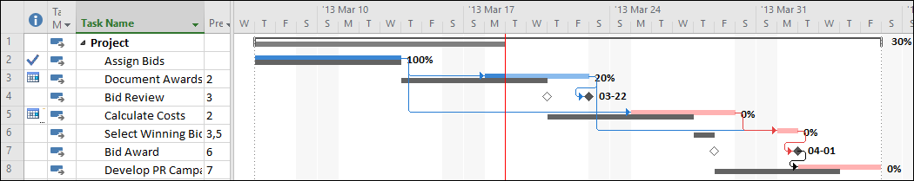
Update Tom Jeff Sue Carol 12.1 mpp
Reset your first 2 Activities to 0% complete and perform a post baseline change. First shift Calculate Costs 2 days later in the schedule. You can do this by dragging the task to the right. You’ll see a popup window, select the 2nd option to “… keep the link.” Note the ripple effect on the remaining tasks. Second, shift Document Awards 2 days later in the schedule.
Select “Project Update” again to see progress on a post baseline revised schedule.

Slide 23
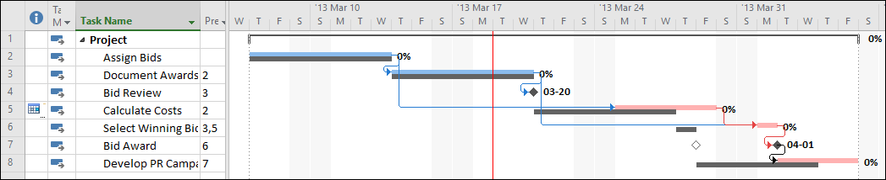
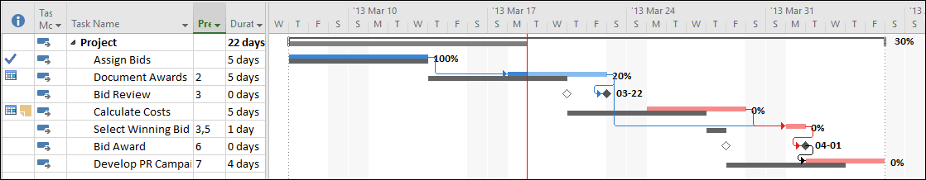
Update Tom Jeff Sue Carol 12.1 mpp
Reset your first 2 Activities to 0% complete and perform a post baseline change, shift Calculate Costs 2 days later in the schedule. You can do this by dragging the task to the right.
You’ll see a popup window, select the 2nd option to “… keep the link.”
Select “Project Update” again and you can see your progress on a post baseline revised schedule.

Slide 24
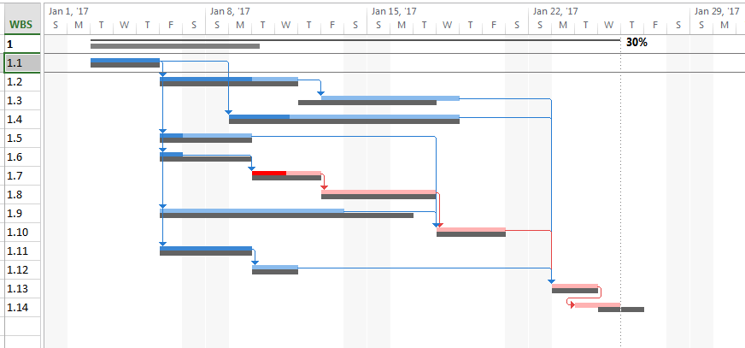
Exercise: Understanding a Tracking Gantt Chart
This is an important exercise that may require 20 minutes or more to complete
M10 HANDOUT Tracking Gantt w question blanks.docx
Use Word
Printout
Or
Or you can use the next slide for your answers
Use PPT

Slide 25


Understanding a Tracking Gantt Chart
You can key in your answers here
Work in groups (or as an individual) to answer these questions from the previous chart (this is a 40 hour work week):
 | Question | Answer
1 | We are not working weekends, how many are there in the project?
2 | What are the 2 most likely status dates?
3 | What is the longest duration of any revised activities (activities different from the baseline)?
4 | Do any revised activities (activities different from the baseline) have a lag?
5 | Which activity(ies) was most likely to have had crashing executed?
6 | Any signs of a lead in either the baseline or the revised schedule?
7 | Does any baseline activity have a lag?
8 | What is the longest baseline duration?
9 | Which activities are most likely to have crashing planned but not executed?
10 | Which activity(ies) has the highest % complete, but is not 100%?
11 | How many WP’s are there?
12 | Which Activities in the revised schedule (all activities in the upper bar) have slack?

Slide 26
In-Class Graded Assessment (or for Online Sections, an Online Proxy Quiz Assessment)
See your professor and/or course announcements for instructions.
This will be a paper handout for on-campus sections, and an FOL Quiz assessment for Online sections.

Slide 27
Summary
Understand the nature of the control cycle and four key steps in a general project control model.
Understand the use of milestones including variations in MS Project
Understand the use of a Tracking Gantt Chart in MS Project.
Recognize the strengths and weaknesses of common project evaluation and control methods.

Slide 28
Homework
Refer to the Start Here section of this module
Read for the next module
Kerzner 12th Ed p 512-529, 11th p. 752-773
PMBOK 6th Ed 6.6, 7.4.2, 5th 6.7, 7.4.2
Review PPT files with solutions
Assignments, practice quizzes and graded quizzes, check the Course at a Glance and FOL/Content/Course Assignments & FOL/Evaluations/Quizzes

Slide 29
